Slide 1

Data Analyst Capstone Project Report
Joe Ailabouni
05/16/2026

Slide 2



OUTLINE
Executive Summary
Introduction
Methodology
Results
Visualization – Charts
Dashboard
Discussion
Findings & Implications
Conclusion
Appendix

Slide 3

EXECUTIVE SUMMARY
This report analyzes the Stack Overflow Developer Survey to uncover technology trends, compensation patterns, and demographic insights across the global developer community.
JavaScript, Python, and HTML/CSS dominate as the most widely used programming languages; PostgreSQL and MySQL lead database usage.
Python and Rust show the strongest growth in desired technologies for next year, signaling a shift toward data science and systems programming.
PostgreSQL is the most desired database, overtaking MySQL in popularity.
AWS and Microsoft Azure are the dominant platforms both currently and in future preference.
The 25-34 age group represents 41.3% of respondents, reflecting a young and growing developer workforce.
Data wrangling, EDA, and dashboards were completed using Python (pandas, matplotlib, seaborn) and IBM Cognos Analytics.

Slide 4

INTRODUCTION
Purpose: To analyze the Stack Overflow Developer Survey and identify technology trends, future preferences, and developer demographics to support data-driven decision making.
The survey captures responses from over 65,000 developers worldwide, providing a comprehensive view of the global technology landscape.
Target Audience: Technology leaders, hiring managers, educators, and developers seeking insights into industry trends.
Value: Insights help organizations align technology investments, hiring strategies, and training programs with real-world developer preferences.
Data was collected via IBM Cloud-hosted CSV files and analyzed using Python, SQLite, and IBM Cognos Analytics.
Job postings data collected via GitHub Jobs API and stored in job-postings.xlsx.
Language salary data scraped from web sources and stored in popular-languages.csv.

Slide 5

METHODOLOGY
Data sources, Data collection & Data wrangling steps
Data Source: Stack Overflow Developer Survey (2024) hosted on IBM Cloud Object Storage. Over 65,000 global respondents.
Web Scraping: Programming language popularity and salary data scraped using Python and saved to popular-languages.csv.
Data Wrangling: Removed duplicates, handled missing values via median imputation and row deletion, normalized compensation data, and encoded categorical variables.
Tools Used: Python (pandas, matplotlib, seaborn, sqlite3), Jupyter Notebooks, IBM Cognos Analytics. Final cleaned dataset saved as survey_cleaned.csv.
EDA performed to identify distributions, correlations, and outliers across all key variables.
Visualizations created across 10+ lab notebooks covering histograms, scatter plots, bubble plots, pie charts, stacked bars, and line charts.

Slide 6
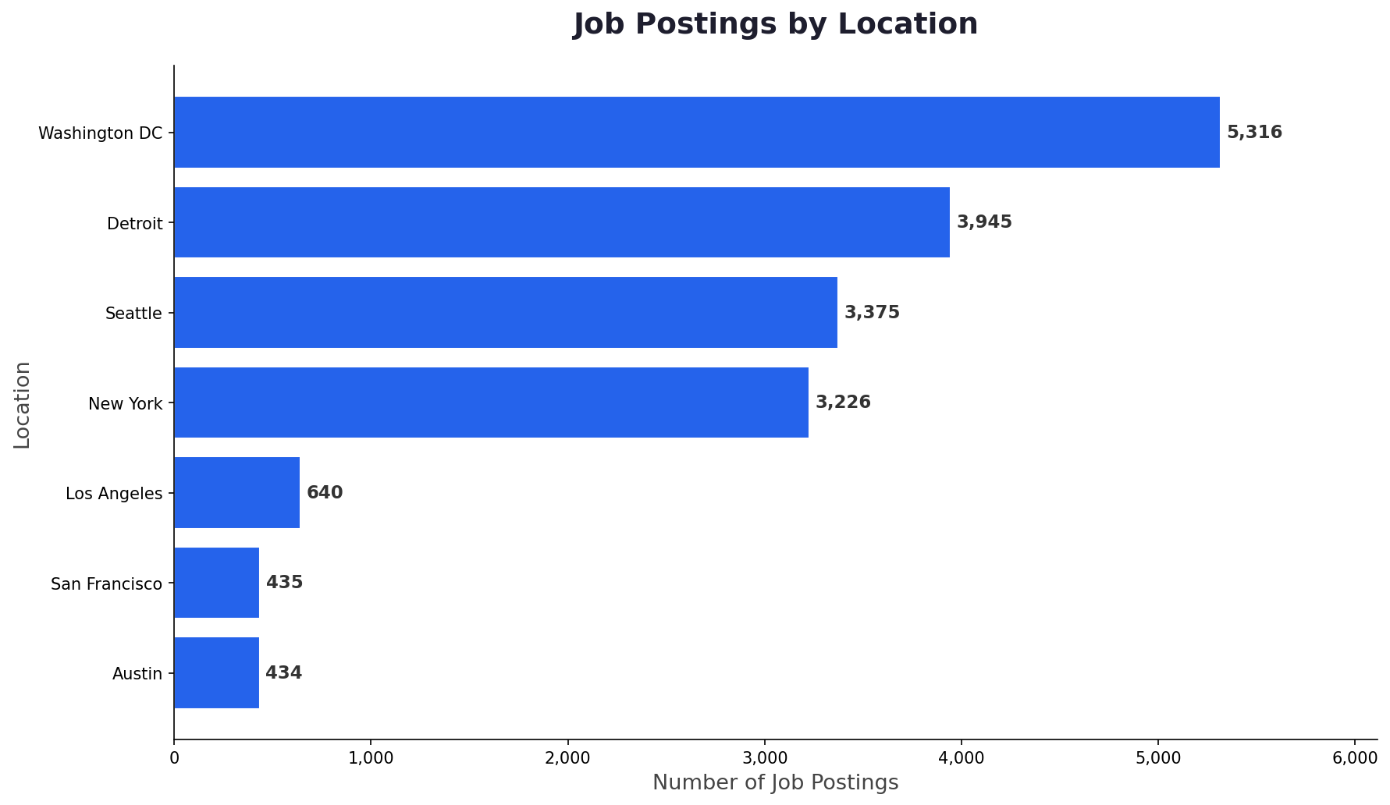
JOB POSTINGS
Top job titles by posting count from job-postings.xlsx. Python Developer, Data Engineer, and Java Developer roles lead in demand, ordered by descending number of postings.

Slide 7
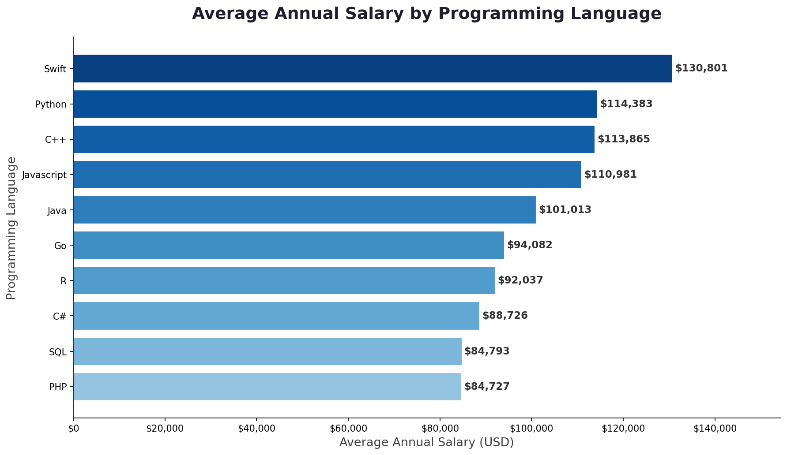
POPULAR LANGUAGES
Average annual salaries by programming language from popular-languages.csv. Scala, Go, and Kotlin command the highest compensation. Data was collected via web scraping and ordered by descending average salary.

Slide 8
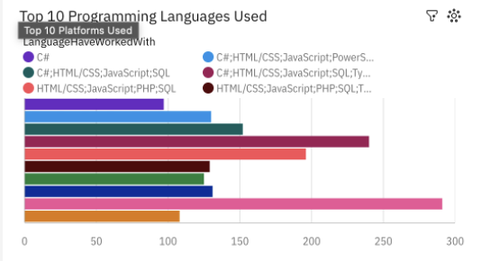
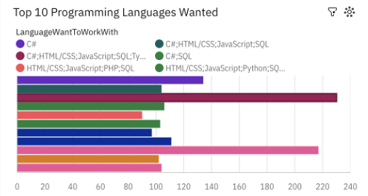
PROGRAMMING LANGUAGE TRENDS
Python surges as the #1 most desired language. Rust and Go show significant growth in demand. TypeScript continues to rise while PHP declines.
Top languages currently: JavaScript, HTML/CSS, Python, SQL, TypeScript, Bash/Shell, Java, C#, C++, PHP.
Top languages wanted: Python, JavaScript, TypeScript, Rust, Go, HTML/CSS, SQL, Kotlin, Swift, C++.

Slide 9
PROGRAMMING LANGUAGE TRENDS - FINDINGS & IMPLICATIONS
Findings
JavaScript remains the most used language but Python is now the most desired, reflecting the rise of data science and AI.
Rust and Go are rapidly gaining popularity as developers seek performance-focused and cloud-native languages.
TypeScript has overtaken plain JavaScript in desired usage, indicating a shift toward type-safe development.
Implications
Organizations should invest in Python training programs to meet growing developer demand and talent market expectations.
Rust and Go expertise will become increasingly valuable for systems programming and cloud-native application development.
TypeScript adoption should be encouraged in web development teams to improve code quality and maintainability.

Slide 10
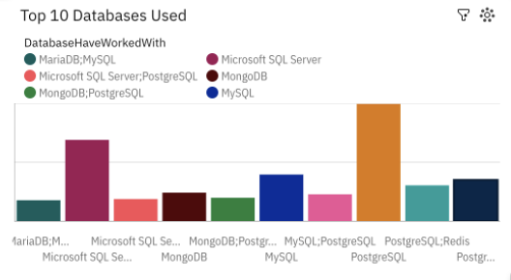
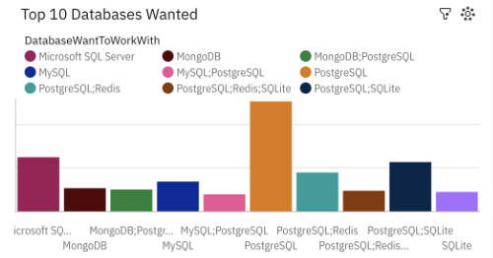
DATABASE TRENDS
PostgreSQL overtakes MySQL as the most desired database. NoSQL options like MongoDB and Redis are growing in preference. Cloud-native databases (Supabase, Firebase) are emerging strongly.
Current top databases: MySQL, PostgreSQL, SQLite, Microsoft SQL Server, MongoDB, Redis, MariaDB, Elasticsearch, Oracle, DynamoDB.
Desired databases: PostgreSQL, MongoDB, Redis, MySQL, SQLite, Elasticsearch, Firebase, Supabase, DynamoDB, Cassandra.

Slide 11
DATABASE TRENDS - FINDINGS & IMPLICATIONS
Findings
PostgreSQL has become the most desired database, surpassing MySQL for the first time, driven by its advanced features and open-source nature.
MongoDB and Redis continue to grow as developers increasingly adopt NoSQL solutions for scalability and performance.
Cloud-native databases like Supabase and Firebase are emerging as popular choices, reflecting the shift toward serverless architectures.
Implications
Teams should consider migrating legacy MySQL workloads to PostgreSQL to align with industry trends and take advantage of advanced SQL features.
Investing in MongoDB and Redis expertise will position engineering teams for high-performance, scalable application architectures.
Cloud-native database skills (Supabase, Firebase) should be incorporated into developer training roadmaps to prepare for serverless development trends.

Slide 12
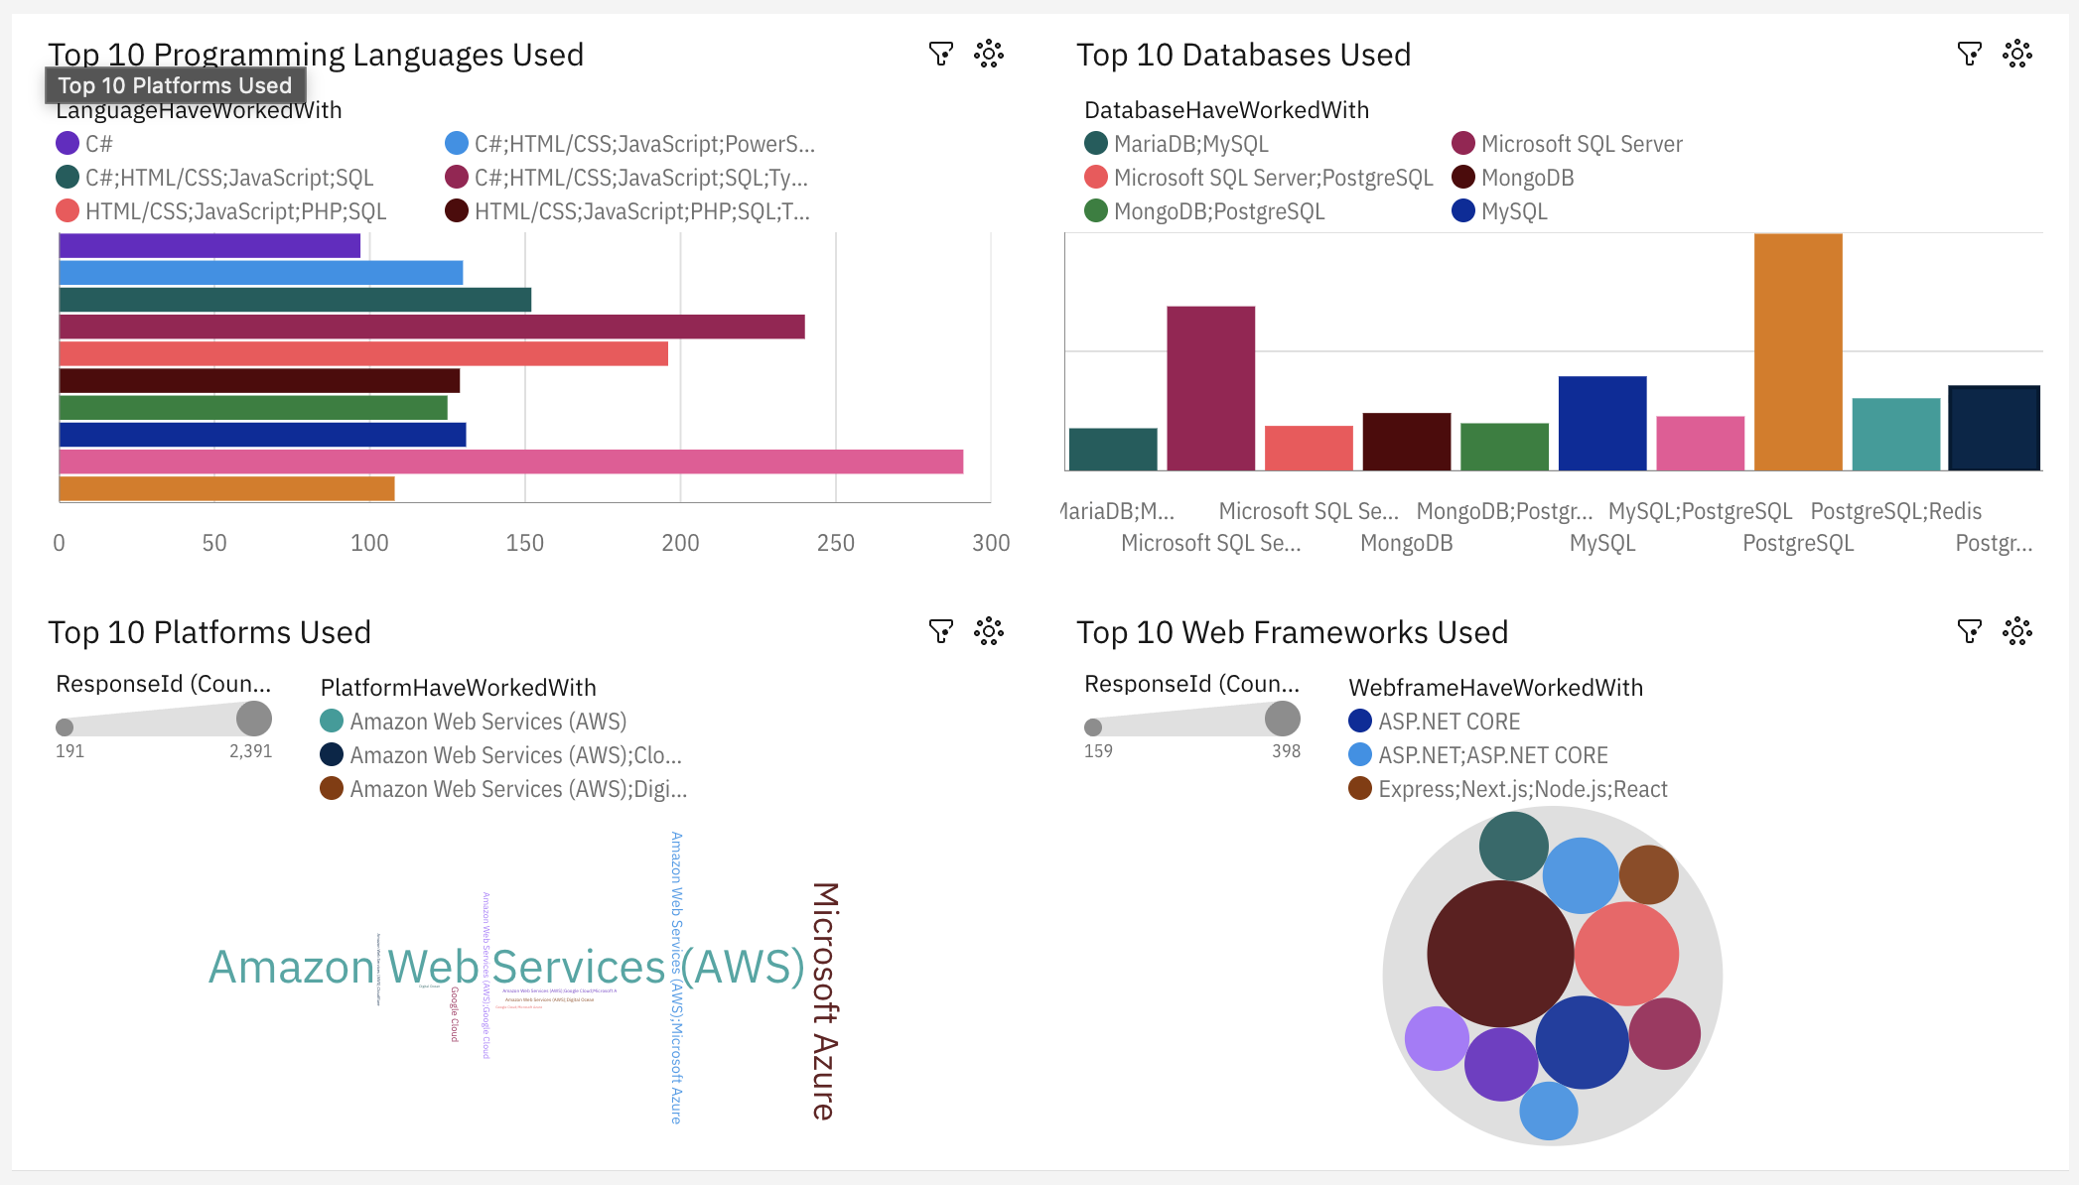
DASHBOARD TAB 1: Current Technology Usage
JavaScript and HTML/CSS dominate current language usage. PostgreSQL and MySQL are the leading databases. AWS is the most widely used platform. React and Node.js lead web frameworks. The developer community shows strong adoption of open-source and cloud technologies.

Slide 13
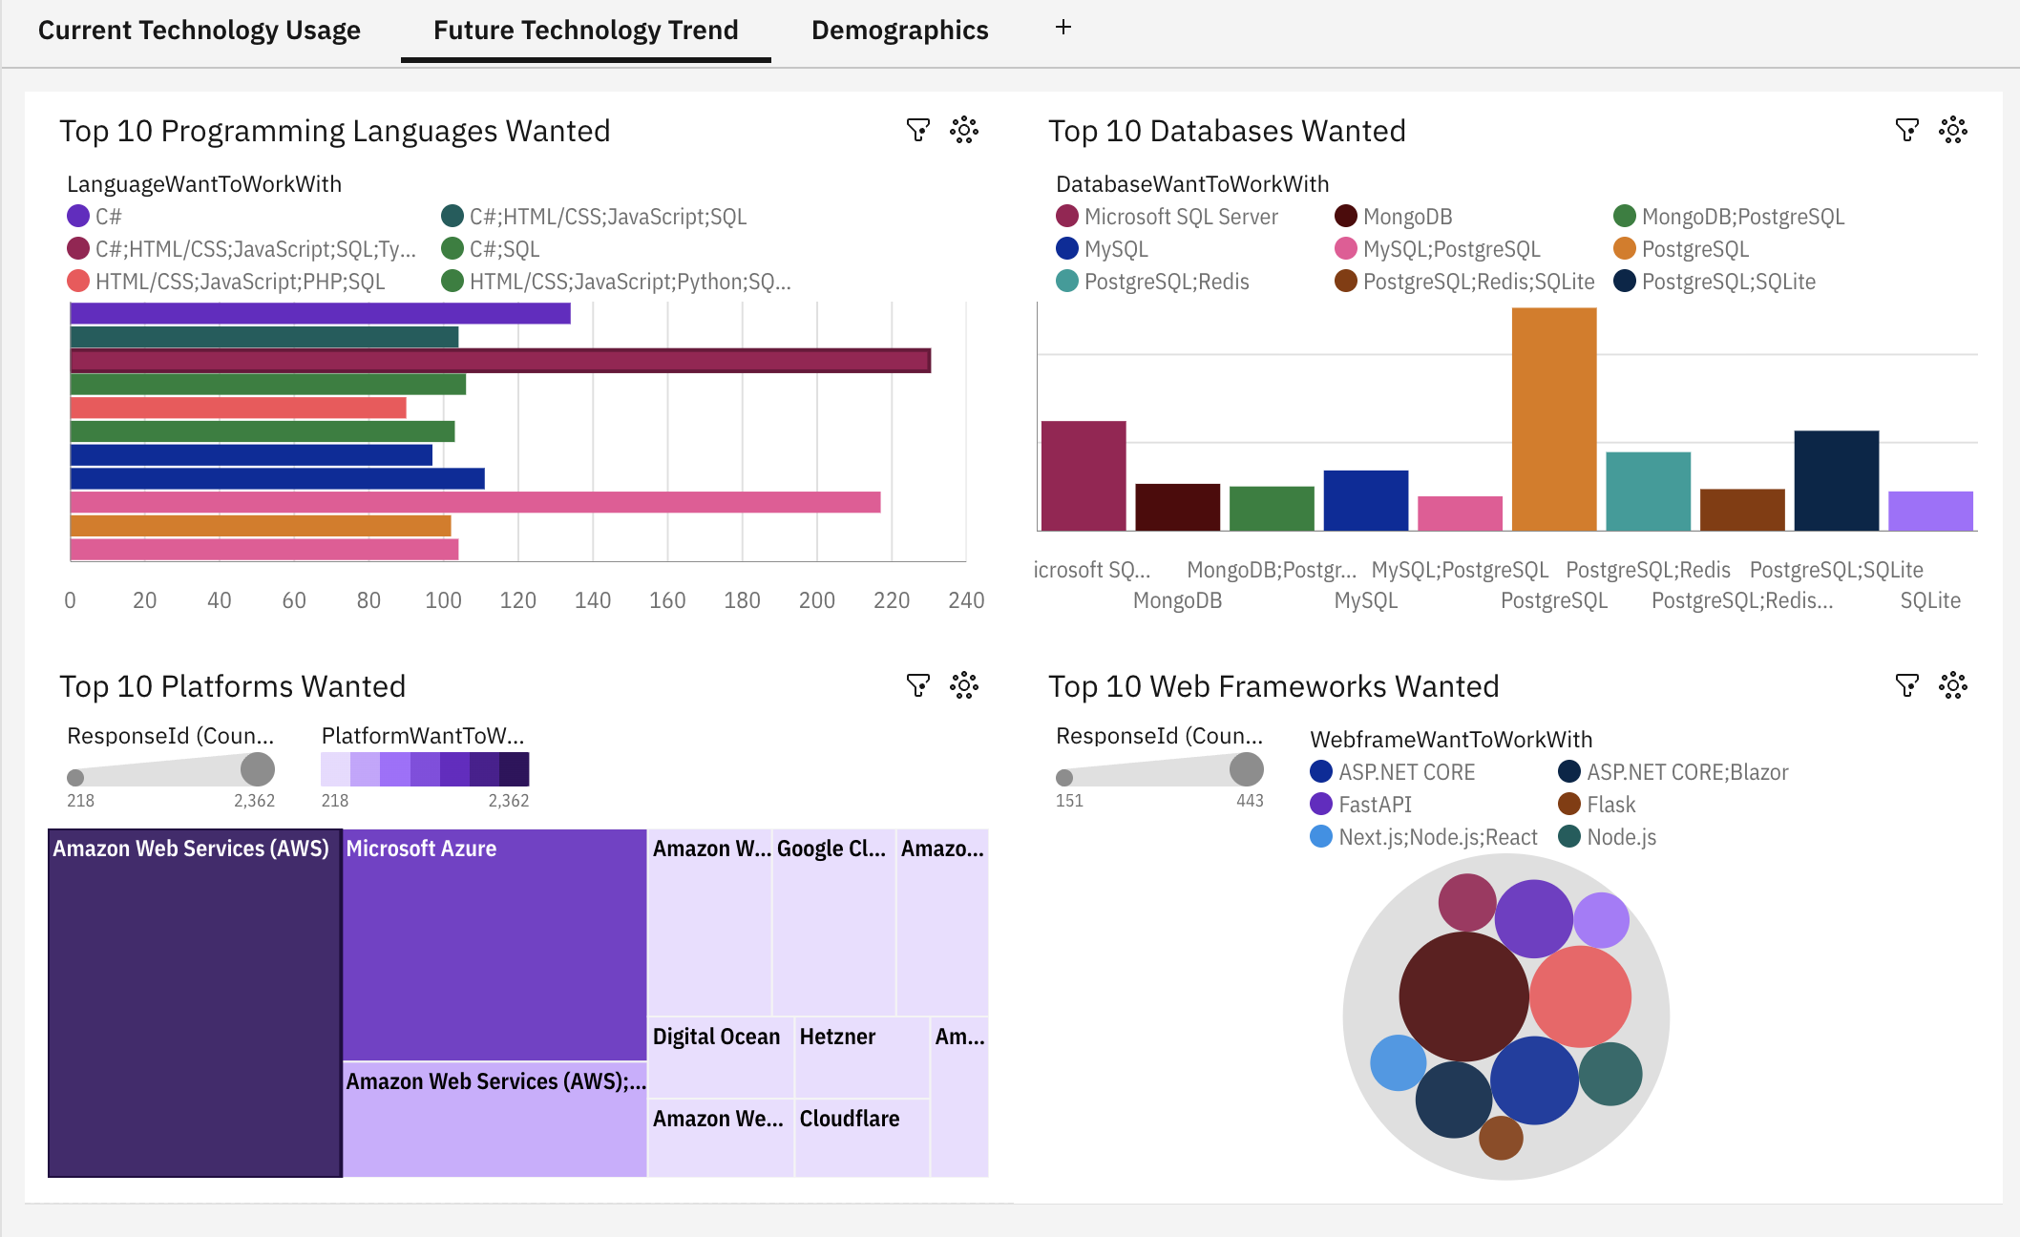
DASHBOARD TAB 2: Future Technology Trends
Python and Rust are the most desired languages for next year. PostgreSQL overtakes MySQL as the most wanted database. AWS and Microsoft Azure remain the top platforms developers want to work with. Next.js and FastAPI emerge as highly desired web frameworks.

Slide 14
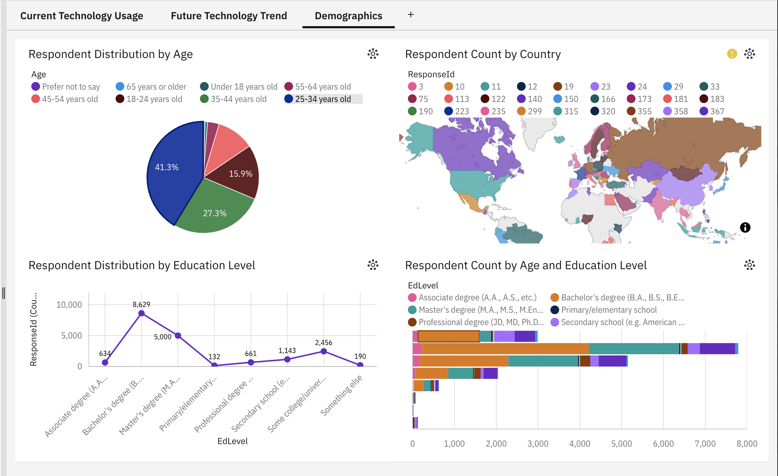
DASHBOARD TAB 3: Demographics
The 25-34 age group represents 41.3% of all respondents, making it the dominant demographic. The US, India, and Germany have the highest respondent counts. Bachelor's degree holders make up the largest education group (8,629 respondents), followed by Master's degree holders (5,000). Compensation increases with age, peaking in the 55-64 group.

Slide 15

DISCUSSION
The three dashboards collectively reveal a technology ecosystem in rapid transition. The developer workforce is skewing younger and more globally distributed, with the 25-34 cohort dominating. Python's rise to the top desired language reflects the mainstreaming of AI and data science across all industries. Cloud platforms (AWS, Azure) have become table stakes, while emerging tools like Rust, Go, and PostgreSQL signal where the next generation of infrastructure is headed. The strong preference for open-source technologies across all three tabs suggests that cost, flexibility, and community support are primary drivers of technology adoption decisions.

Slide 16
OVERALL FINDINGS & IMPLICATIONS
Findings
Python has emerged as the single most desired programming language, overtaking JavaScript for the first time, driven by AI, ML, and data science adoption.
The global developer community is predominantly young (25-34), highly educated (bachelor's degree+), and geographically concentrated in the US, India, and Germany.
Open-source technologies (PostgreSQL, Linux, AWS) dominate both current usage and future preferences, confirming a strong industry shift away from proprietary platforms.
Implications
Educational institutions and bootcamps should prioritize Python, cloud platforms, and data skills in their curricula to align with market demand.
Employers targeting the largest developer talent pool should focus recruiting efforts on the 25-34 demographic and geographies with high developer density.
Technology vendors should invest in open-source ecosystems and cloud-native integrations, as developers overwhelmingly prefer open, flexible toolchains over proprietary alternatives.

Slide 17

CONCLUSION
The Stack Overflow Developer Survey analysis confirms that Python, PostgreSQL, and cloud platforms (AWS, Azure) represent the core technology stack of the modern developer, both today and in the near future.
Emerging technologies like Rust, Go, and Supabase are gaining significant traction, indicating that performance, safety, and developer experience will be the key drivers of adoption in coming years.
The demographic data highlights a need for diversity initiatives, as the developer community remains predominantly young, male, and concentrated in a small number of countries despite being globally distributed.
This capstone project demonstrates a complete data analysis lifecycle: from data collection (API, web scraping) through wrangling, EDA, visualization, and dashboard creation — delivering actionable insights from raw survey data.

Slide 18

APPENDIX
Additional analyses completed during this capstone include: Histogram distributions of CompTotal and YearsCodePro (Labs 17-18), Box plot comparisons of compensation by age group and employment type (Lab 18), Scatter and bubble plots exploring Age vs. WorkExp and Compensation vs. Job Satisfaction (Labs 19-20), Stacked bar charts of Job Satisfaction by Age Group and Employment Type (Lab 22), Line charts of median compensation trends across experience levels (Lab 23), Pie charts of top databases, platforms, and collaboration tools (Lab 21). All visualizations were created using Python (matplotlib, seaborn) and IBM Cognos Analytics. Source data: Stack Overflow Developer Survey 2024, IBM Cloud Object Storage.

